Slide 1
Lecture 3.2
Building a Web Server with FastAPI
Andy Aymeloglu - UATX Software Engineering

Slide 2
A working handler, the hard way
import socket
sock = socket.socket()
sock.bind(("127.0.0.1", 8000))
sock.listen()
while True:
conn, _ = sock.accept()
req = conn.recv(4096).decode()
# request line looks like: "GET /ping HTTP/1.1"
first_line = req.split("\r\n")[0]
method, path, _ = first_line.split(" ")
if method == "GET" and path == "/ping":
body = "pong"
resp = (
"HTTP/1.1 200 OK\r\n"
f"Content-Length: {len(body)}\r\n"
"Content-Type: text/plain\r\n"
"\r\n"
+ body
)
conn.sendall(resp.encode())
conn.close()
Python
Notes:
Walk through live. Admit you needed help writing it.

Slide 3
You could keep going...
That handler only does ONE thing: GET /ping returns "pong".
To build a real chat API, you'd need to write, from scratch:
  Routing - a table mapping (method, path) to functions
  Path parameters - /messages/42 needs to extract the 42
  Body parsing - JSON in, JSON out, with useful errors when it's wrong
  Validation - is this actually a string? a number in range?
  Error handling - turn exceptions into proper HTTP responses
  Docs - so the frontend team knows what endpoints exist
  Concurrency - handle more than one request at a time
Or you could use a framework that already did all of that.
  Today that framework is FastAPI.
Notes:
Don't introduce FastAPI yet; type hints detour first.

Slide 4
But First, a Brief Detour
Notes:
New material. Pitch: you've seen these in the wild, here's what they're for.

Slide 5
Types in Python: a reprisal
  def greet(name, times):
  return ("hello " + name + " ") * times

Slide 6
Types in Python: a reprisal
Modern Python lets you annotate function arguments and return values:
  def greet(name: str, times: int = 1) -> str:
  return ("hello " + name + " ") * times

Slide 7
Types in Python: a reprisal
Modern Python lets you annotate function arguments and return values:
  def greet(name: str, times: int = 1) -> str:
  return ("hello " + name + " ") * times
The `: str`, `: int`, and `-> str` parts are type hints.
  They describe what the function expects and what it returns.
You'll see them all over modern Python libraries.
  FastAPI, Pydantic, SQLAlchemy. The standard library itself.

Slide 8
Python itself ignores them
At runtime, Python does NOT enforce type hints.
  def greet(name: str) -> str:
  return name.upper()
  greet(42) # no error from Python itself
  # (until .upper() blows up on the int)
They are hints, not checks. Python just stores them as metadata on the function object.
So why bother writing them?
Notes:
Point: hints are data that other code can read.

Slide 9
Python itself ignores them
At runtime, Python does NOT enforce type hints.
  def greet(name: str) -> str:
  return name.upper()
  greet(42) # no error from Python itself
  # (until .upper() blows up on the int)
They are hints, not checks. Python just stores them as metadata on the function object.
So why bother writing them?
  Reason 1: your editor reads them for autocomplete and warnings.
  Reason 2: other *libraries* can read them and do real work.
Notes:
Point: hints are data that other code can read.

Slide 10
Libraries can read your type hints at runtime
Python gives you a way to inspect a function's signature at runtime:
  import inspect
  sig = inspect.signature(greet)
  # sig tells you: name is str, times is int with default 1, returns str
A library can use that information to:
  Parse incoming JSON and validate it against your expected types
  Cast a URL string "42" into an int before passing it to your function
  Auto-generate API documentation from the function signatures
  Serialize your return value into JSON automatically
FastAPI is the library that takes this idea as far as it can go.
  Every feature you're about to see is the same trick:
  read the function signature, do something useful with it.
Notes:
Refer back to this slide for every FastAPI feature that follows.

Slide 11
FastAPI: Hello World

Slide 12
Library vs Framework
A library works within your software. Your software works inside a framework.

Slide 13
The entire hello-world app
Python
# install once:
# pip install fastapi uvicorn
# app.py
from fastapi import FastAPI
app = FastAPI()
@app.get("/")
def hello():
return {"msg": "hi"}
# run it:
# uvicorn app:app --reload
Notes:
Compare to slide 1's socket handler: same GET, no socket or byte code.

Slide 14
What @app.get("/") actually does
The `@app.get("/")` line above the function is a decorator.
  A decorator is Python syntax for 'wrap this function with something.'
  @app.get("/")
  def hello():
  return {"msg": "hi"}
This is equivalent to: 'take the function `hello`, and register it with the FastAPI app as the handler for GET /.'
Notes:
Don't explain decorators deeply. Name it, show the shape, move on.

Slide 15
What @app.get("/") actually does
The `@app.get("/")` line above the function is a decorator.
  A decorator is Python syntax for 'wrap this function with something.'
  @app.get("/")
  def hello():
  return {"msg": "hi"}
This is equivalent to: 'take the function `hello`, and register it with the FastAPI app as the handler for GET /.'
FastAPI keeps a table of (method, path) -> function.
  When a request comes in, it looks up the handler and calls it.
  This is the routing piece you would have had to write by hand.
Five more decorators you'll use: @app.post, @app.put, @app.patch,
  @app.delete, @app.get - one per HTTP verb.
Notes:
Don't explain decorators deeply. Name it, show the shape, move on.

Slide 16
Wait, what's uvicorn?
FastAPI is a library for defining routes and handling requests.
  It does not actually listen on a network port itself.
uvicorn is a separate thing: an ASGI server.
  It does the socket-level work we Clauded on Tuesday’s slide:
  listens on a port, accepts connections, parses HTTP, calls
  FastAPI with each request, writes the response bytes back.
Notes:
ASGI: Asynchronous Server Gateway Interface, successor to WSGI.

Slide 17
Wait, what's uvicorn?
FastAPI is a library for defining routes and handling requests.
  It does not actually listen on a network port itself.
uvicorn is a separate thing: an ASGI server.
  It does the socket-level work we wrote by hand in Section 1:
  listens on a port, accepts connections, parses HTTP, calls
  FastAPI with each request, writes the response bytes back.
Why the split?
  Your app code cares about routes, validation, business logic.
  uvicorn cares about sockets, HTTP framing, concurrency.
  Each side can be swapped out independently.
Notes:
ASGI: Asynchronous Server Gateway Interface, successor to WSGI.

Slide 18
Wait, what's uvicorn?
FastAPI is a library for defining routes and handling requests.
  It does not actually listen on a network port itself.
uvicorn is a separate thing: an ASGI server.
  It does the socket-level work we wrote by hand in Section 1:
  listens on a port, accepts connections, parses HTTP, calls
  FastAPI with each request, writes the response bytes back.
  uvicorn app:app --reload
  ^^^^^^^ ^^^ ^^^ ^^^^^^^^
  server file var auto-restart on code change
Notes:
ASGI: Asynchronous Server Gateway Interface, successor to WSGI.

Slide 19
Wait, where does `pip install` put things?
When you run `pip install fastapi`, where does fastapi actually go?
Notes:
Point: installing into system Python has worked so far by luck.

Slide 20
Wait, where does `pip install` put things?
When you run `pip install fastapi`, where does fastapi actually go?
By default: into your system Python. All projects share one
  giant pile of packages. This is bad.
Notes:
Point: installing into system Python has worked so far by luck.

Slide 21
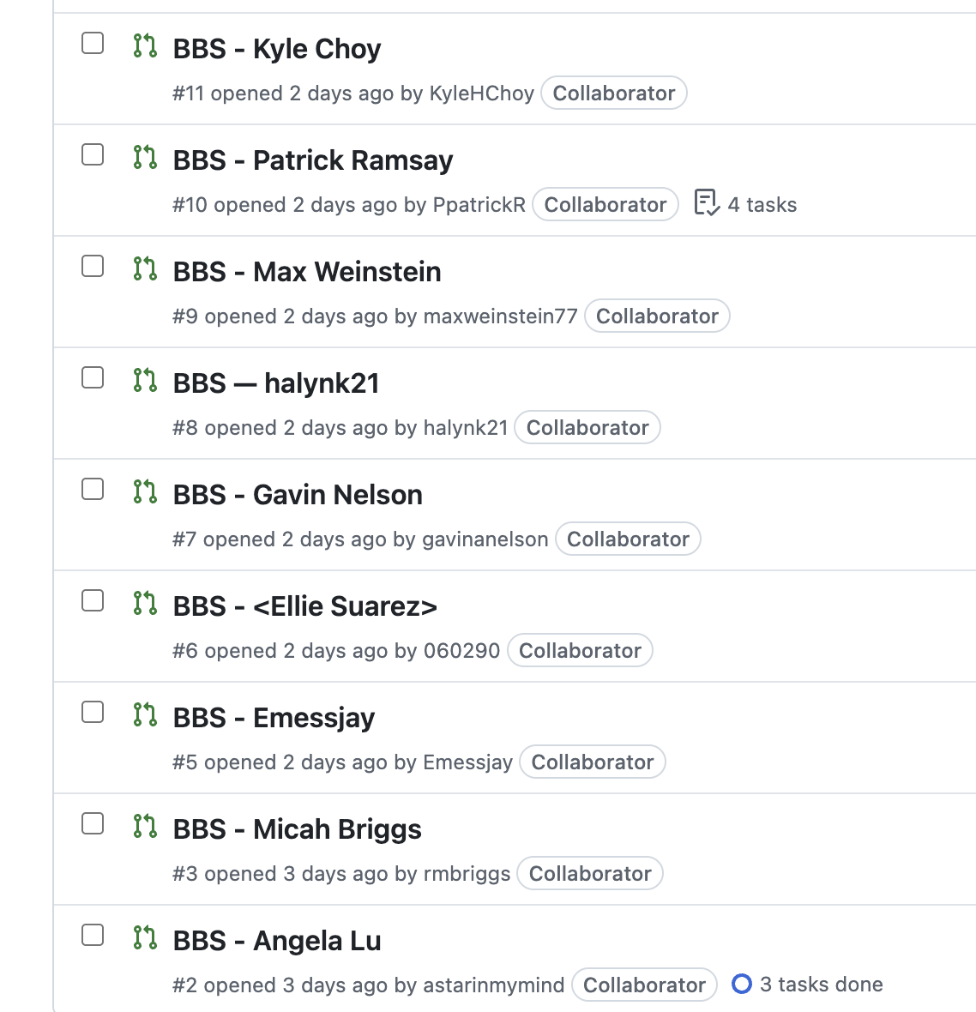
Wait, where does `pip install` put things?
When you run `pip install fastapi`, where does fastapi actually go?
By default: into your system Python. All projects share one
  giant pile of packages. This is bad.
Notes:
Point: installing into system Python has worked so far by luck.

Slide 22
Wait, where does `pip install` put things?
When you run `pip install fastapi`, where does fastapi actually go?
By default: into your system Python. All projects share one
  giant pile of packages. This is bad.
Imagine you have two projects on your laptop:
  Project A needs fastapi 0.100
  Project B needs fastapi 0.115 (with a different API shape)
Share one system Python and you can only have one version installed.
  Whichever one you pinned most recently wins. The other project breaks.
Notes:
Point: installing into system Python has worked so far by luck.

Slide 23
Wait, where does `pip install` put things?
When you run `pip install fastapi`, where does fastapi actually go?
By default: into your system Python. All projects share one
  giant pile of packages. This is bad.
Introducing a virtual environment. A per-project folder that holds its own Python interpreter and its own set of installed packages.
Each project gets isolation. Each project pins what it needs.
Notes:
Point: installing into system Python has worked so far by luck.

Slide 24
venv + requirements.txt: the standard loop
bash
# one-time setup per project
$ cd chat-app/
$ python3 -m venv venv # creates ./venv/ folder
$ source venv/bin/activate # activates it (prompt changes)
(venv) $ pip install fastapi uvicorn
# record exactly what you installed
(venv) $ pip freeze > requirements.txt
# requirements.txt is plain text, one package per line:
# fastapi==0.115.0
# uvicorn==0.30.6
# pydantic==2.9.2
# ...
# later, on a different machine (or for a teammate):
$ python3 -m venv venv
$ source venv/bin/activate
(venv) $ pip install -r requirements.txt # reinstalls everything
Notes:
This is the A2 workflow. Docker in week 7 formalizes the same idea.

Slide 25
What Type Hints Buy You

Slide 26
Path parameters: type-checked for free
Python
@app.get("/messages/{id}")
def get_message(id: int):
return {"id": id, "text": f"message {id}"}
# GET /messages/42 -> {"id": 42, "text": "message 42"}
# GET /messages/hi -> 422 Unprocessable Entity
# {"detail": [{"msg": "value is not a valid
# integer", "type": "type_error.integer"}]}
# You wrote zero validation code. FastAPI read `id: int`,
# tried to cast the URL fragment to int, and returned 422
# automatically when it couldn't.
Notes:
Point at `id: int`.

Slide 27
Query parameters: same trick
Python
@app.get("/messages")
def list_messages(
limit: int = 20,
channel: str | None = None,
):
# Any argument not in the path becomes a query parameter.
# Defaults mean optional. Type hints drive validation.
...
# GET /messages -> limit=20, channel=None
# GET /messages?limit=5 -> limit=5, channel=None
# GET /messages?channel=general&limit=50 -> limit=50, channel="general"
# GET /messages?limit=abc -> 422 (not an int)
Notes:
`str | None` is union syntax, Python 3.10+.

Slide 28
Pydantic: the type hint for a JSON body
Python
from pydantic import BaseModel
class MessageCreate(BaseModel):
author: str
text: str
@app.post("/messages")
def post_message(body: MessageCreate):
# body.author and body.text are already validated strings.
# FastAPI parsed the JSON, checked the shape, and handed us
# a typed Python object.
return {"id": 1, "author": body.author, "text": body.text}
# POST /messages {"author": "alice", "text": "hi"}
# -> {"id": 1, "author": "alice", "text": "hi"}
# POST /messages {"author": "alice"} # missing text
# -> 422 with "text: field required" in the body
Notes:
Pydantic does the validation; FastAPI just calls it.

Slide 29
Headers: also just function arguments
Python
from fastapi import Header
@app.post("/messages")
def post_message(
body: MessageCreate,
x_author: str = Header(),
):
# The `= Header()` marker tells FastAPI: don't look for
# this in the path or the query string; look in the request
# headers. The argument name is mangled: `x_author` matches
# the `X-Author` header. Underscore becomes dash, case is
# ignored.
return {"author_from_header": x_author, "text": body.text}
# curl -X POST http://localhost:8000/messages \
# -H "Content-Type: application/json" \
# -H "X-Author: alice" \
# -d '{"text": "hi"}'
# -> {"author_from_header": "alice", "text": "hi"}
# Missing the header -> 422 automatically.
Notes:
A2 uses this: X-Username header.

Slide 30
Constraints: type hints with more metadata
Python
from pydantic import BaseModel, Field
class MessageCreate(BaseModel):
author: str = Field(min_length=3, max_length=20,
pattern=r"^[a-zA-Z0-9_]+$")
text: str = Field(min_length=1, max_length=500)
# POST /messages {"author": "al", "text": "hi"}
# -> 422 "author: String should have at least 3 characters"
# POST /messages {"author": "has spaces", "text": "hi"}
# -> 422 "author: String should match pattern ..."
# POST /messages {"author": "alice", "text": ""}
# -> 422 "text: String should have at least 1 character"
# A plain `str` says 'it's a string.'
# `Field(...)` says 'it's a string AND here are the rules.'
# Same idea: more metadata on the hint, more validation for free.
Notes:
Also ge, le, gt, lt for numbers; defaults; aliases.

Slide 31
Same idea for query parameters: Query()
Python
from fastapi import Query
@app.get("/messages")
def list_messages(
limit: int = Query(50, ge=1, le=200),
offset: int = Query(0, ge=0),
):
# ge = greater than or equal, le = less than or equal.
# Default limit is 50. Clamped to [1, 200]. Default offset 0, no max.
...
# GET /messages -> limit=50, offset=0
# GET /messages?limit=10 -> limit=10, offset=0
# GET /messages?limit=0 -> 422 (below ge=1)
# GET /messages?limit=999 -> 422 (above le=200)
# GET /messages?offset=-1 -> 422 (below ge=0)
# `Field(...)` constrains a Pydantic model field.
# `Query(...)` constrains a query parameter.
# `Path(...)`, `Header(...)`, `Body(...)` exist too - same pattern.
Notes:
A2 expects these constraint keywords.

Slide 32
Returning data: FastAPI handles the JSON
Python
class MessageOut(BaseModel):
id: int
author: str
text: str
timestamp: str
@app.get("/messages/{id}", response_model=MessageOut)
def get_message(id: int):
# You return a dict (or a Pydantic model, or a SQL row...).
# FastAPI converts it to JSON based on the response_model hint.
return {
"id": id,
"author": "alice",
"text": "hi",
"timestamp": "2026-04-11T14:22:00Z",
}

Slide 33
Free interactive docs at /docs
Because FastAPI knows every endpoint's signature, it can generate
  an interactive documentation page automatically.
Start uvicorn, then visit http://localhost:8000/docs in a browser.
You get:
  A list of every endpoint, grouped by path
  The request shape (path params, query params, body schema)
  The response shape
  A 'Try it out' button that sends real requests from the browser
Nobody wrote this doc. It was generated entirely from reading your function signatures.
Notes:
One signature drives validation, serialization, and docs.

Slide 34
Building the Chat API
Notes:
Layout to mimic for A2.

Slide 35
Project layout
For the chat API we'll split the code into three python files plus the supporting cast:
  chat-app/
  app.py FastAPI app and route definitions
  db.py database connection and schema
  schemas.py Pydantic models (request and response shapes)
  chat.db the SQLite file itself (gitignored, created on first run)
  requirements.txt pinned list of packages to install
  venv/ the virtual env (gitignored, not committed)
Why split it up?
  app.py is the HTTP layer: routes, validation, error handling.
  db.py is the data layer: how we talk to SQLite.
  schemas.py is the contract layer: what the API accepts and returns.
Notes:
One job per file: easier to test and change later.

Slide 36
Upgrading from sqlite3 to SQLAlchemy
Last week we used Python's stdlib `sqlite3` module directly.
  `conn = sqlite3.connect("chat.db")` and raw `conn.execute(...)`.
For a real web server, we're going to use SQLAlchemy instead.
  (Just its connection layer - no ORM.)
Two reasons to switch now:
  Connection pooling. A web server handles many requests at once.
  Opening and closing a SQLite connection per request is wasteful.
  SQLAlchemy keeps a pool of open connections and hands them out.
  Dialect portability. The same code works against SQLite,
  Postgres, MySQL, etc. When you move off SQLite later, nothing in
  your app.py has to change.
Everything else stays the same: `text("SELECT ...")` with bind params.
Notes:
Don't go into internals.

Slide 37
db.py - connection and schema
Python
# db.py
from sqlalchemy import create_engine, text
engine = create_engine("sqlite:///chat.db")
def init_db():
with engine.connect() as conn:
conn.execute(text('''
CREATE TABLE IF NOT EXISTS messages (
id INTEGER PRIMARY KEY AUTOINCREMENT,
author TEXT NOT NULL,
text TEXT NOT NULL,
timestamp TEXT NOT NULL
)
'''))
conn.commit()
if __name__ == "__main__":
init_db()
Notes:
Same shape as 2.2. Run `python db.py` once to create the table.

Slide 38
db.py - the data access functions
Python
# db.py (part 2 of 2: queries)
def list_messages() -> list[dict]:
with engine.connect() as conn:
return [dict(r) for r in conn.execute(
text("SELECT id, author, text, timestamp FROM messages")
).mappings().all()]
def create_message(author: str, content: str) -> dict:
ts = datetime.now(timezone.utc).strftime("%Y-%m-%dT%H:%M:%SZ")
with engine.begin() as conn:
r = conn.execute(
text("INSERT INTO messages (author, text, timestamp) "
"VALUES (:author, :text, :ts)"),
{"author": author, "text": content, "ts": ts})
return {"id": r.lastrowid, "author": author,
"text": content, "timestamp": ts}
Notes:
`content` avoids shadowing `text`; `utcnow()` deprecated 3.12+; `delete_message` returns bool for 404.

Slide 39
schemas.py - the contracts
Python
# schemas.py
from pydantic import BaseModel
class MessageCreate(BaseModel):
author: str
text: str
class MessageOut(BaseModel):
id: int
author: str
text: str
timestamp: str
# MessageCreate is what clients SEND us (POST body).
# MessageOut is what we send BACK to clients.
#
# These are contracts. The client promises to send a shape
# that matches MessageCreate, we promise to return a shape
# that matches MessageOut. FastAPI enforces both promises.
Notes:
Why two: input has no id or timestamp, server assigns them.

Slide 40
app.py - the routes
Python
# app.py
from fastapi import FastAPI
import db
from schemas import MessageCreate, MessageOut
app = FastAPI()
@app.get("/api/messages", response_model=list[MessageOut])
def list_messages():
return db.list_messages()
@app.post("/api/messages", response_model=MessageOut, status_code=201)
def create_message(body: MessageCreate):
return db.create_message(body.author, body.text)
# Notice what's NOT here: no `import sqlalchemy`, no SQL strings, no
# datetime. Each handler is one line - call the data layer, return
# the result. FastAPI handles parsing/validation/serialization,
# db.py handles storage, and app.py is just the seam between them.
Notes:
Walk through `status_code=201`: overrides default 200 for creation.

Slide 41
Running it end to end
bash
# Terminal 1: start the server
$ python db.py # one-time: create the table
$ uvicorn app:app --reload
INFO: Uvicorn running on http://127.0.0.1:8000
INFO: Application startup complete.
# Terminal 2: hit it with curl
$ curl http://localhost:8000/api/messages
[]
$ curl -X POST http://localhost:8000/api/messages \
-H "Content-Type: application/json" \
-d '{"author": "alice", "text": "first!"}'
{"id":1,"author":"alice","text":"first!","timestamp":"2026-04-11T14:22:00Z"}
$ curl http://localhost:8000/api/messages
[{"id":1,"author":"alice","text":"first!","timestamp":"2026-04-11T14:22:00Z"}]
Notes:
Run live, both terminals.

Slide 42
Returning errors the right way
What should `DELETE /api/messages/42` do if message 42 doesn't exist?
Notes:
Replaces hand-built error responses from slide 1.

Slide 43
Returning errors the right way
What should `DELETE /api/messages/42` do if message 42 doesn't exist?
In FastAPI you `raise HTTPException`:
  # app.py
  from fastapi import HTTPException
  @app.delete("/api/messages/{id}")
  def delete_message(id: int):
  if not db.delete_message(id):
  raise HTTPException(404, "message not found")
  return {"deleted": id}
FastAPI catches the exception and turns it into a proper HTTP response.
Notes:
Replaces hand-built error responses from slide 1.

Slide 44
ANSWER
Write PATCH /api/messages/{id}
# schemas.py:
class MessageUpdate(BaseModel):
text: str
# app.py:
@app.patch("/api/messages/{id}", response_model=MessageOut)
def update_message(id: int, body: MessageUpdate):
with db.engine.begin() as conn:
result = conn.execute(
text("UPDATE messages SET text = :text WHERE id = :id"),
{"id": id, "text": body.text},
)
if result.rowcount == 0:
raise HTTPException(404, "message not found")
row = conn.execute(
text("SELECT id, author, text, timestamp "
"FROM messages WHERE id = :id"),
{"id": id},
).mappings().first()
return dict(row)
Notes:
Walk through blanks. One field: PATCH is partial. Re-read row after update.

Slide 45
Where this goes next
What just happened:
  Decorator -> route. `@app.get("/path")` registers a handler.
  Type hints -> validation + /docs. Path, query, body, response.
  Pydantic -> request/response contracts. Shape promises, enforced.
  Layering -> SQL stays in db.py; app.py is just routes + calls.
  uvicorn -> actually runs the HTTP server. FastAPI just defines the app.
  requirements.txt -> defining an isolated environment
Assignment 2: take your week-2 chat store and wrap it in a real HTTP API.
  GET, POST, DELETE (at minimum),
  Proper status codes, Pydantic schemas, HTTPException for errors
  Test it with curl before writing any client code

Slide 46
Where this goes next
Next week (4.x): testing this API with pytest.
  How do you prove your endpoints do what they're supposed to do?
  And why is writing tests sometimes the thing that reveals the bug?

